Slide 1
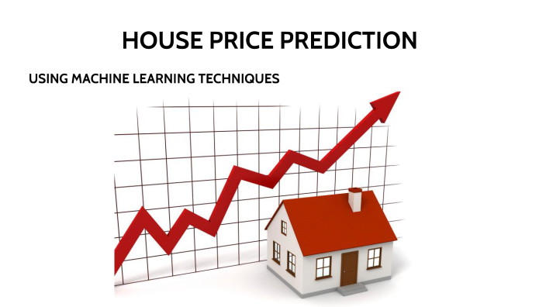
House Price Prediction
- By Bhagyalaxmi Nair

Slide 2

Introduction
House price prediction is crucial in the real estate domain.
Multiple factors such as area, condition, and year built affect property valuation.
Predicting house prices using data-driven techniques.
Helps buyers, sellers, and investors.
This project focuses on predicting house prices using data analysis and machine learning techniques implemented in Python.
House price prediction is a critical task in the real estate industry, as it helps buyers, sellers, and investors make informed decisions.
By analyzing historical housing data, this project aims to identify key factors that influence property prices and build a reliable predictive model.
Accurately estimating house prices is challenging due to the complex interaction of these factors.
This project showcases how data science and machine learning techniques can be applied to analyze housing data and predict property prices.

Slide 3

Problem Statement
Manual house price estimation is inaccurate and subjective.
The goal is to build a reliable data-driven prediction model.
Manually estimating house prices often leads to inaccuracies due to subjective judgment and market fluctuations.
The primary challenge addressed in this project is to develop an automated and data-driven approach for predicting house prices.
The model must handle missing values, outliers, and a combination of numerical and categorical variables.
Determining the correct price of a house is a complex task due to the involvement of multiple interdependent factors.
The challenge addressed in this project is to accurately predict house prices using available property features while handling missing values, outliers, and mixed data types.

Slide 4
Dataset Overview
The dataset used in this project contains detailed information about residential properties, including structural, temporal, and condition-related attributes.
It consists of both numerical and categorical features that collectively influence the final sale price of a house.
Contains numerical and categorical features.
Target variable: Sale Price.
Understand housing data
Perform EDA
Build a prediction model
Evaluate performance

Slide 5

Key Features
Important features in the dataset include lot area, overall condition, year of construction, basement area, and the target variable sale price.
These features play a crucial role in determining the market value of a property.
Features also include LotArea, OverallCond, YearBuilt, TotalBsmtSF, and SalePrice.

Slide 6

Data Types and Tools Used
Data Types: Numerical, categorical, and temporal features.
Tools: Python, Pandas, NumPy, Matplotlib, Scikit-learn, Google Colab.
Target variable: SalePrice.

Slide 7

Methodology
The project follows a systematic methodology starting with data understanding and cleaning.
Exploratory data analysis is then performed to uncover patterns and relationships.
Feature engineering and model building are carried out to develop an effective prediction system.
Data collection, cleaning, EDA, feature engineering, modeling.

Slide 8
Data Cleaning
Data cleaning involves identifying and handling missing values, removing inconsistencies, and treating outliers that may negatively affect model performance.
Proper data cleaning ensures the reliability and accuracy of the analysis.
Missing values and inconsistencies were identified and handled using statistical methods.
Removing inconsistencies, and treating outliers.

Slide 9
Feature Engineering
Feature engineering is a critical step that transforms raw data into meaningful inputs for the model.
This includes encoding categorical variables, scaling numerical features, and creating new derived features that better represent real-world property characteristics.
Relevant transformations and feature creation techniques were applied to improve model performance.
Encoding categorical variables and transforming numerical features.

Slide 10

Model Selection
Regression-based machine learning models are suitable for predicting continuous target variables such as house prices.
Appropriate models are selected based on simplicity, interpretability, and performance on the given dataset.
Mean/median imputation and impact analysis.
Understanding patterns and trends.
Continuous variables examined using plots.
Encoding zoning and building types.
Identification of extreme values.
Identifying strong relationships with Sale Price.
Training models using processed data.

Slide 11

Evaluation Metrics
The performance of the prediction model is evaluated using metrics such as Mean Absolute Error (MAE), Root Mean Square Error (RMSE), and R-squared score.
These metrics provide insights into prediction accuracy and model reliability.
MAE, RMSE, and R² Score used to evaluate model performance.

Slide 12

Results & Insights
The results indicate that features such as lot area, construction year, and basement size have a strong influence on house prices.
The analysis confirms that larger and newer houses generally command higher market values.
The analysis shows that property size, construction year, and basement area have a strong influence on house prices.
House prices increase with area and newer construction.
Basement and condition also impact pricing.

Slide 13

Future Scope
The project can be extended by incorporating additional features such as location-based indicators and neighborhood information.
Advanced machine learning algorithms and larger datasets can further improve prediction accuracy and robustness.
Add location-based features and advanced ML models.
Use larger datasets for better accuracy.

Slide 14
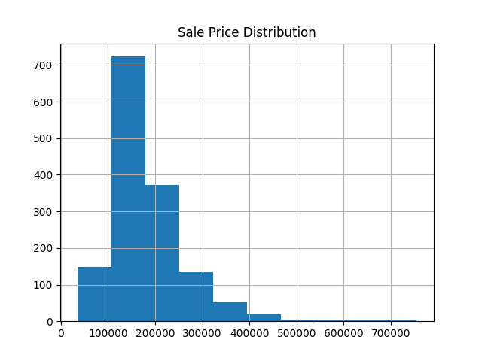
Sale Price Distribution
Insight: The histogram represents the distribution of house prices across the dataset. It indicates that most properties are concentrated within a mid-price range, while very high-priced houses occur less frequently.

Slide 15
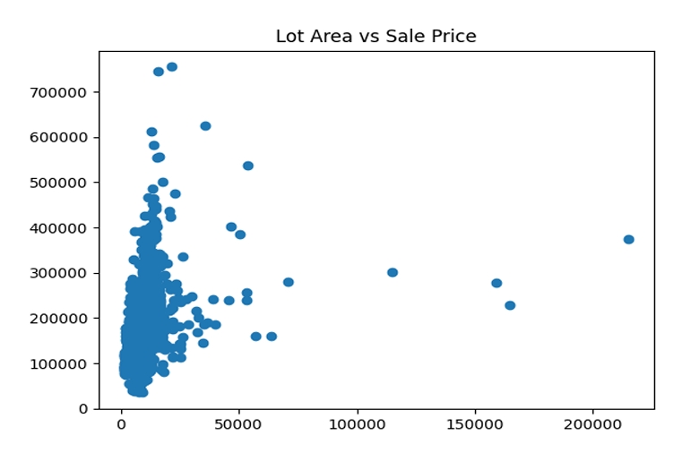
Lot Area vs Sale Price
Insight: This scatter plot shows a positive relationship between lot area and sale price. Although larger lots generally result in higher prices, the spread indicates that other factors also influence property valuation.

Slide 16
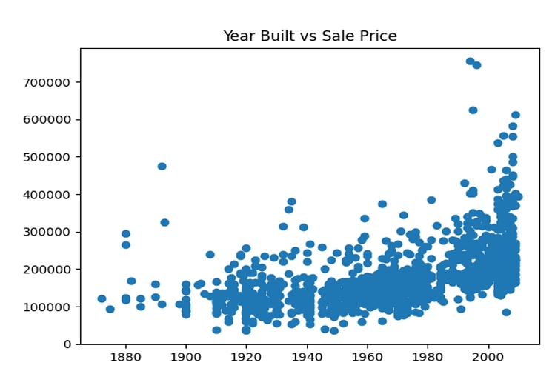
Year Built vs Sale Price
Insight: The visualization highlights that newer houses tend to be sold at higher prices. This trend reflects improved construction quality, modern amenities, and buyer preferences.

Slide 17
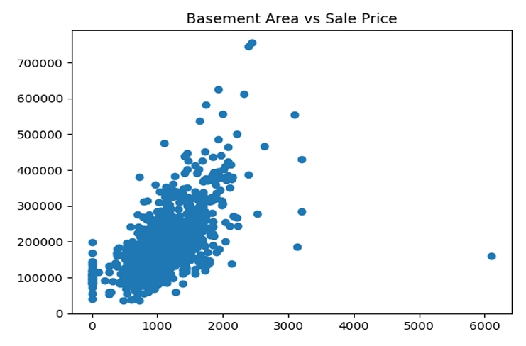
Basement Area vs Sale Price
Insight: The plot indicates that houses with larger basement areas usually have higher sale prices. Basements add usable space and increase the overall value of the property.

Slide 18

Conclusion
This project successfully demonstrates the application of data analysis and machine learning techniques for predicting house prices.
The insights obtained from the analysis highlight the importance of key property features and showcase the effectiveness of data-driven decision-making in the real estate domain.
The project successfully demonstrates house price prediction using Python.
It highlights the value of data-driven decision-making.
Supports smarter real estate decisions.

Slide 19


